Slide 1

Machine Learning
Lecture 2 – Decision Trees & Random Forests

Slide 2
Overview
Decision Trees
Tree Construction Methods
Splitting Criteria
Parameters
Pruning
Ensemble
Random Forest

Slide 3
Decision Trees (1)
Decision Trees (DT) are algorithms, which extracts relationships (rules) between different variables and makes decisions (classification/regression).
Alternatively, it can be represented as a set of rules: if-then.
Benefits:
Work even under the presence of missing values.
Work even with both numerical and categorical values.
Quite interpretable!
DT includes:
Root: The root node of the tree. The most important node of the tree that determines how the dataset should split initially.
Nodes: Represent the conditions (rules) that decide how the dataset will be split, based on a feature.
Branch: The outcome of a test which lead to another node.
Leaf: Represent the final decision of the tree.

Slide 4
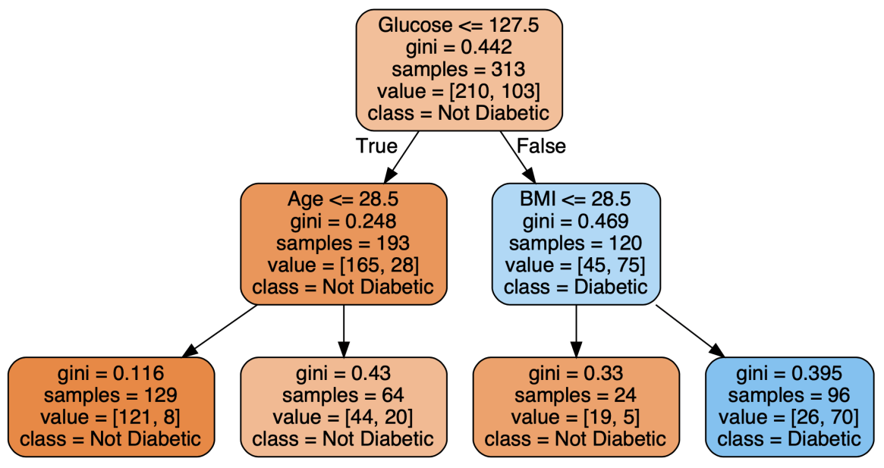
Decision Trees (2)
If glucose <= 127.5 then LEFT else RIGHT
If Age <= 28.5 then LEFT else RIGHT
If BMI <= 28.5 then LEFT else RIGHT
Decision Tree of Depth 3 in diabetes classification task.

Slide 5
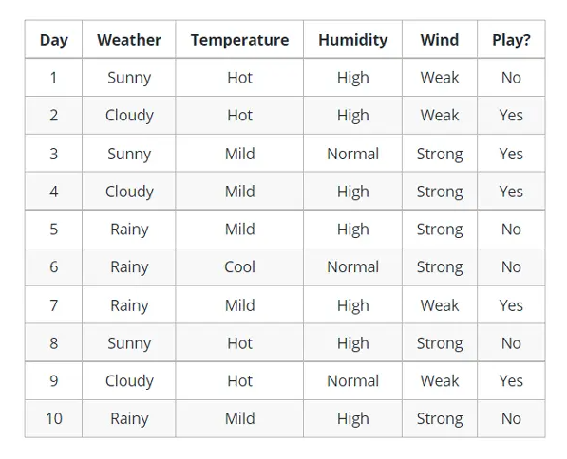
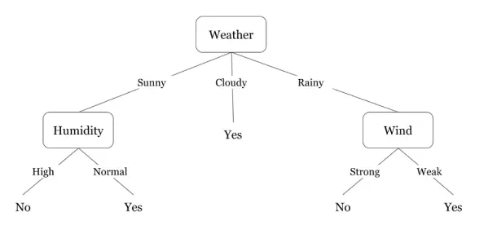
Tree Construction Example

Slide 6
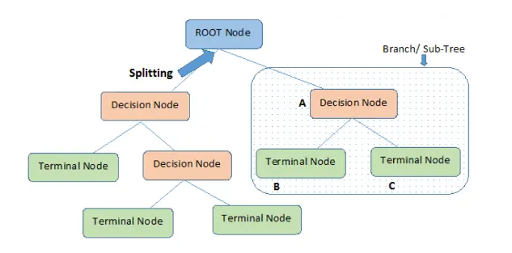
Tree Construction Methods (1)
Selecting the Best Attribute: Using a metric (Gini impurity, entropy, or information gain, etc.), the best attribute to split the data is selected (root).
Splitting the Dataset: The dataset is split into subsets based on the selected attribute.
Repeating the Process: The process is repeated recursively for each subset (decision node), creating a new decision node or a terminal node (leaf) until a stopping criterion is met (e.g., all instances in a node belong to the same class or a predefined depth is reached).

Slide 7
Tree Construction Methods (2)
Brute-Force: Tries all possible combinations (Impossible for large datasets)
ID3: Splits each node using information gain as criterion. The idea is to split the node is such a way that minimizes the entropy (or maximizing the information gain). Low entropy (High information gain) indicates that the tree is more certain for its decisions.
C4.5: Extension of ID3, supports numerical values, missing values and applies pruning to prevent overfitting.
CART: Similar to C4.5, but utilizes binary trees only.
Classification Criterion:
Gini
Cross-Entropy
Log-Loss
Regression Criterion:
MSE

Slide 8
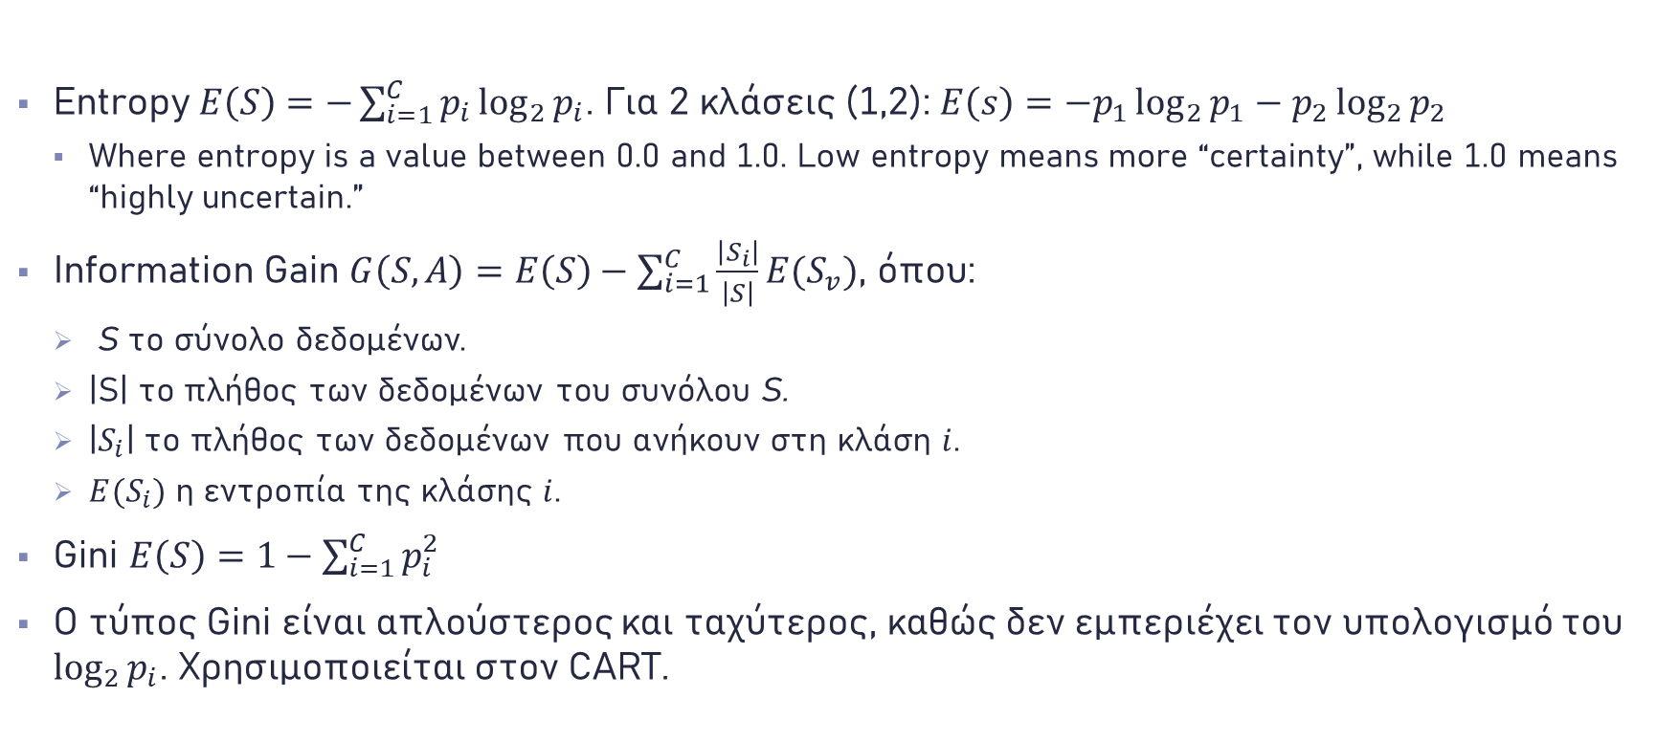
Splitting Criteria
Entropy $E\left(S\right)=−\sum_{i=1}^{C}{p_{i}\log_{2}{p_{i}}}$. Για 2 κλάσεις (1,2): $E\left(s\right)=−p_{1}\log_{2}{p_{1}}−p_{2}\log_{2}{p_{2}}$
Where entropy is a value between 0.0 and 1.0. Low entropy means more “certainty”, while 1.0 means “highly uncertain.”
Information Gain $G\left(S,A\right)=E\left(S\right)−\sum_{i=1}^{C}{\frac{\left|S_{i}\right|}{\left|S\right|}E(S_{v})}$, όπου:
S το σύνολο δεδομένων.
|S| το πλήθος των δεδομένων του συνόλου S.
|$S_{i}$| το πλήθος των δεδομένων που ανήκουν στη κλάση $i$.
$E(S_{i})$ η εντροπία της κλάσης $i$.
Gini $E\left(S\right)=1−\sum_{i=1}^{C}{p_{i}^{2}}$
Ο τύπος Gini είναι απλούστερος και ταχύτερος, καθώς δεν εμπεριέχει τον υπολογισμό του $\log_{2}{p_{i}}$. Χρησιμοποιείται στον CART.

Slide 9
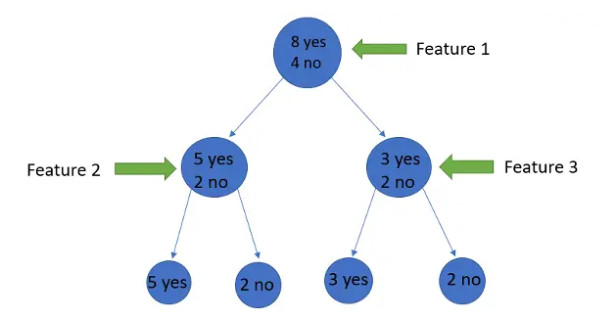
Criterion Example (1)
If entropy is utilized, feature 2 or feature 3 predicts better the class of a sample?

Slide 10
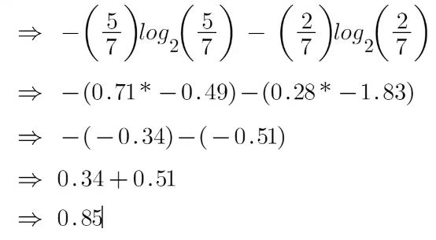
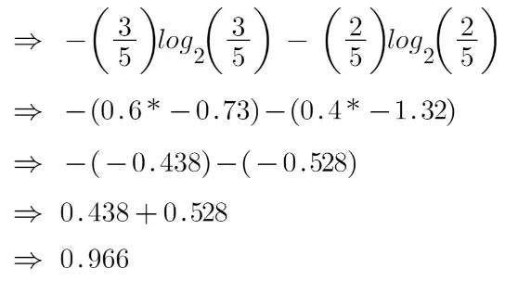
Criterion Example (2)
For feature 2:
For feature 3:
Conclusion: feature 2 minimizes Entropy, so it’s more important than feature 2. This is because Feature 2 has more samples that belong to “yes” class, making the tree more certain that if a sample goes left, it is probably a yes. On the other hand,
feature 3 has almost 50-50 probability for each class.

Slide 11
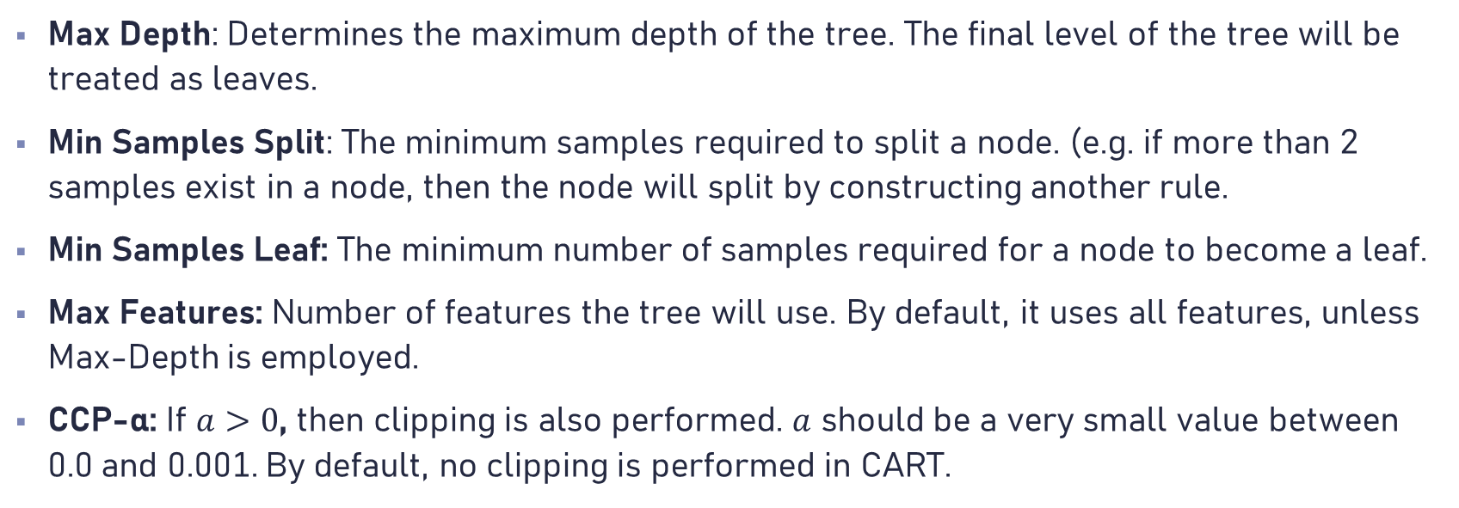
Parameters
Max Depth: Determines the maximum depth of the tree. The final level of the tree will be treated as leaves.
Min Samples Split: The minimum samples required to split a node. (e.g. if more than 2 samples exist in a node, then the node will split by constructing another rule.
Min Samples Leaf: The minimum number of samples required for a node to become a leaf.
Max Features: Number of features the tree will use. By default, it uses all features, unless Max-Depth is employed.
CCP-α: If $a>0$, then clipping is also performed. $a$ should be a very small value between 0.0 and 0.001. By default, no clipping is performed in CART.

Slide 12
Decision Tree Disadvantages
Prone to overfitting.
Unstable to noisy data.
Unstable to datasets with unbalanced classes.
Low performance in regression tasks.

Slide 13
Ensemble
Ensemble methods combine multiple weak predictors to make more accurate decisions.
Example: A single decision tree is weak, but if we combine the predictions of multiple decision trees, we construct a stronger model.
Advantages:
Reduce overfitting
Increase generalization ability
Robust to noise
Disadvantages:
Increases time complexity
The combined model is no longer interpretable
The ideal number of weak estimators is unknown and must be found manually.

Slide 14
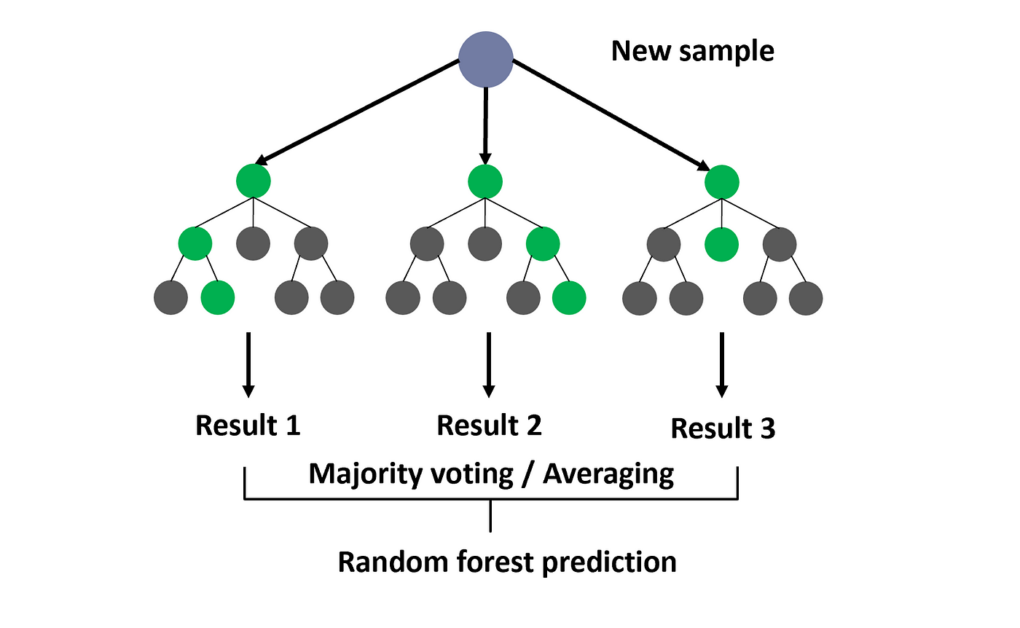
Random Forest
Construct multiple decision trees (Estimators).
Each decision tree uses only a subset of features.
Voting Technique: Computes the average decision from all trees.

Slide 15
Machine Learning
Lecture 2 – Decision Trees & Random Forests

